Slide 1
Contributions

Slide 2
Juan Ochoa
CRC cards discussion and fixing
Testing Ands, Global and Until scope, AfterL patterns.

Slide 3
Oscar Diaz
-Worked and collaborated on the CRC cards
-Collaboration and Discussion on the subsystem model
-Collaborated with some of the 160 tests for different classes
-Worked on global classes

Slide 4
Jose Macias

Slide 5
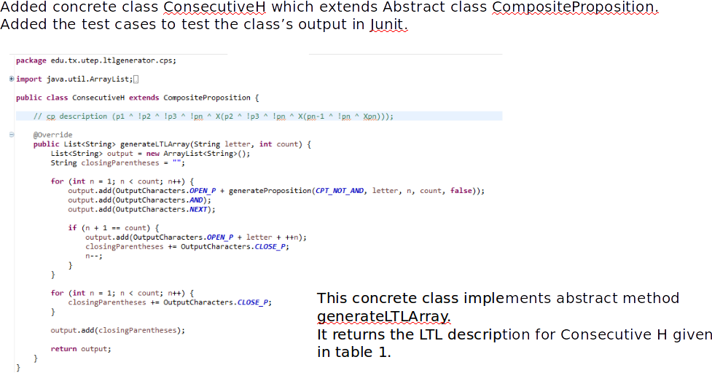

Slide 6
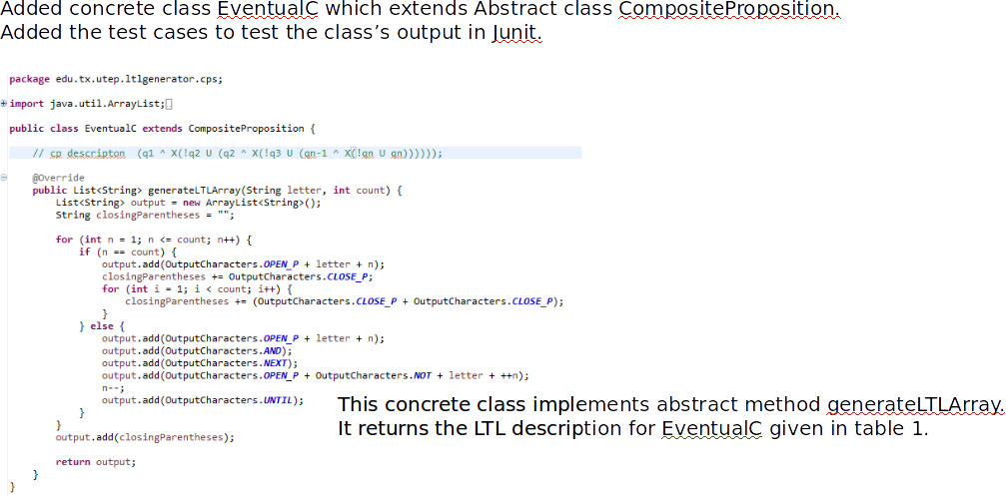

Slide 7
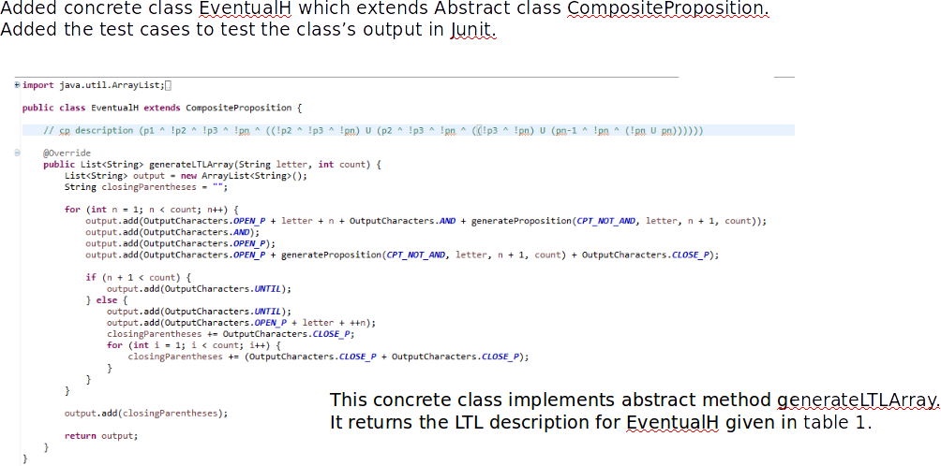

Slide 8
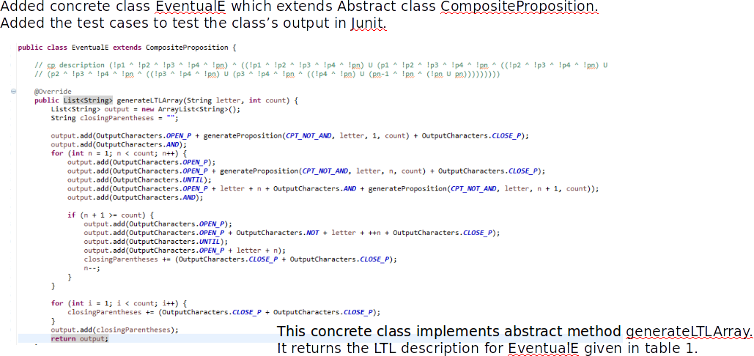

Slide 9
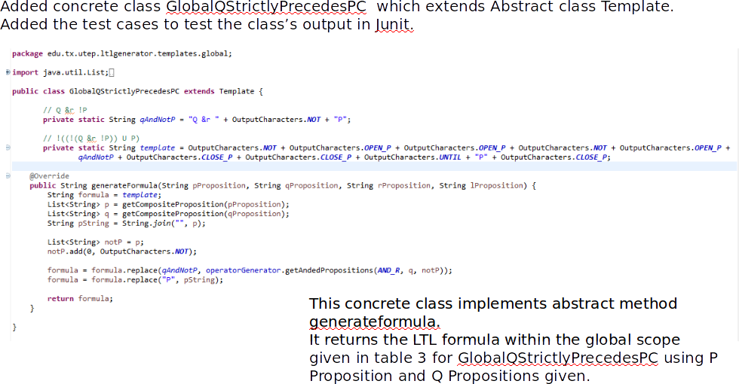

Slide 10
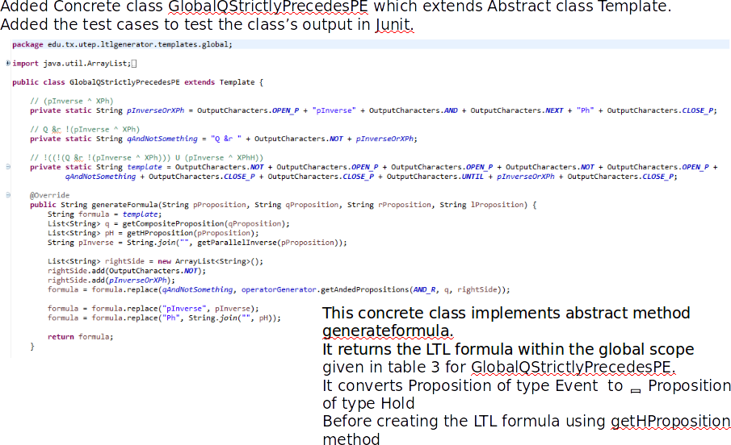

Slide 11
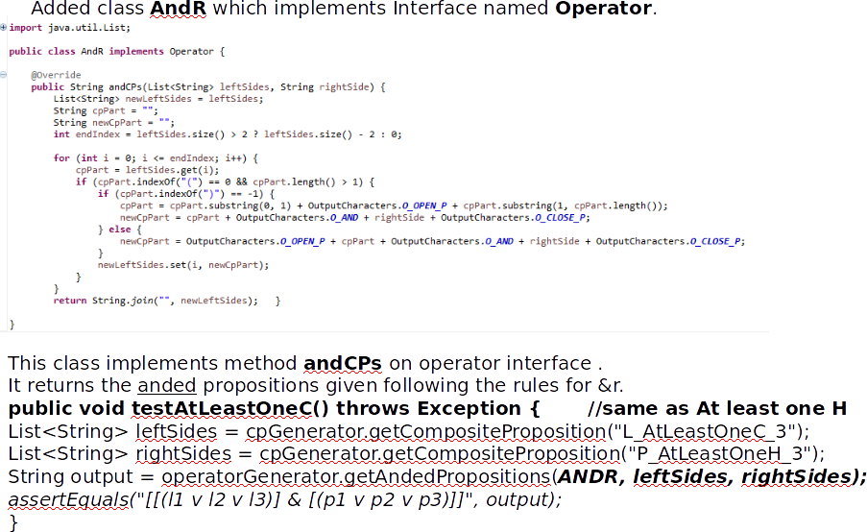

Slide 12
